Slide 1
Protons in IOTA Ring
Eric Prebys, Fermilab APC

Slide 2
Where to get protons
Luckily, we have an extra RFQ just lying around…
The HINS (“High Intensity Neutrino Source”) was developed as the front end of a pulsed “Project X” 8 GeV proton linac
Because of cooling problems, it never reached its design pulse rate
ProjectX (now PIP-II) specification was changed to a CW front end
HINS->PXIE
HINS RFQ available for our use

Slide 3
RFQ Design and Specifications
Pulsed 4-vane RFQ:

Slide 4
Rate Limitation
HINS was designed to operate at a 1% duty factor
Large tune shifts were seen at the .1% level (~Hz x ~mA)
A design flaw caused water leaks at ~30 cooling channel couplings within the RFQ, such that vacuum could not be maintained
-> No cooling
Increased temperature resulted in the observed tune shifts.
Bad for them, but no problem for us.
As the RFQ heats up, this flange bulges, causing a parasitic mode to mix and shift the resonant frequency

Slide 5
HINS Parameters for IOTA
matched to IOTA momentum, but β=.073!
Is this big enough?
misreported as 2.
Why no one will steal this RFQ from us

Slide 6
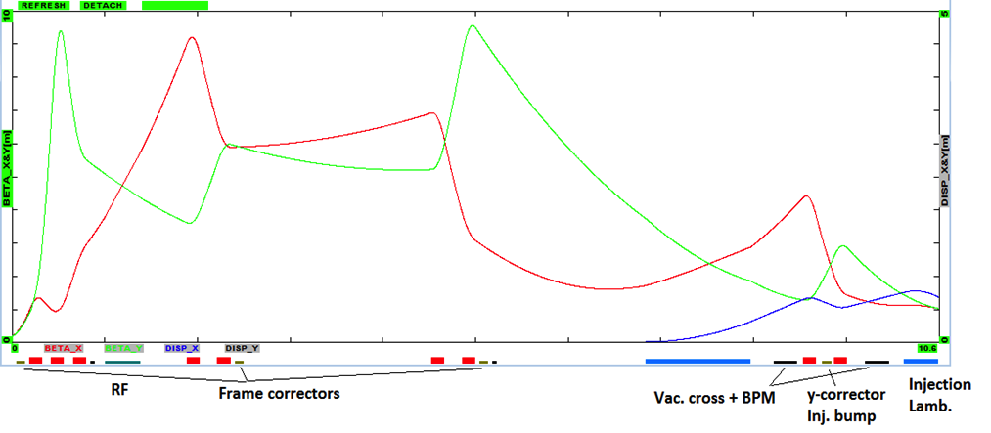
Layout in IOTA

Slide 7
RF System
1 kV, 30 MHz, h=4 electron system ➔ h=56 for protons
Not enough to fully bunch beam (~1/3)
Enough for BPMs
Adding 1 kV, 2.2 MHz, h=4 proton RF

Slide 8
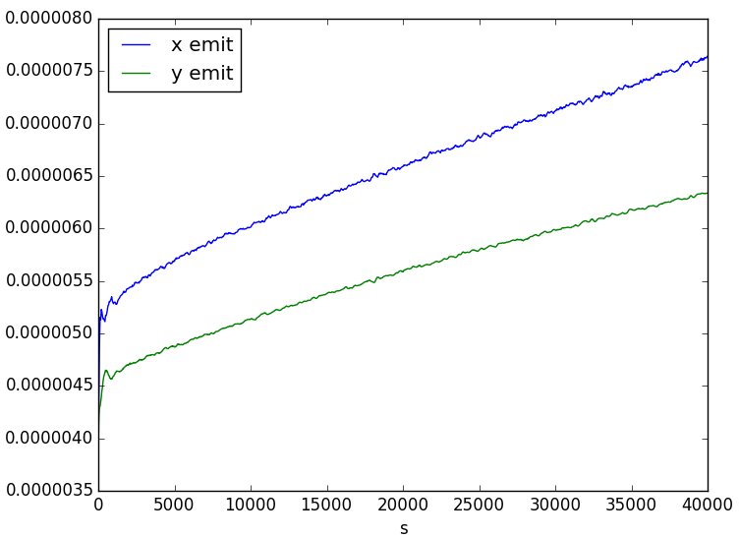
Emittance Growth
Synergia Simulation, first 1000 turns, no nonlinear elements:

Slide 9
Questions and issues
Instrumentation
BPMs for position measurement.
What do do for beam profiles?
IPM?
gas jet scattering?
electron beam probe?
quadrupole BPM?
Beam
What are the options for increasing current/decreasing emittance?
Multi-turn injection?

Slide 10
Possible Future Upgrade: H- injection
Install a stripping foil in the 30° bend?
Still investigating bump configuration
Not currently scoped.

